Slide 1
Doctor Appointment System
Varsha Jaywant Parab
UID: O23MCA110129
Master of Computer Application
Chandigarh University

Slide 2
Introduction
Online doctor appointment booking system
Designed to improve convenience for patients and doctors
Aims to reduce manual work and waiting time

Slide 3
Project Objectives
Book appointments online
Maintain digital records
Help doctors manage patient flow
Reduce paperwork and human errors

Slide 4
Scope of the Project
Applicable in hospitals, clinics, and health centers
Available 24/7 through the web
Accessible to patients and doctors across locations

Slide 5
Problem Definition
Manual systems are error-prone and slow
Difficult to maintain records and ensure security
Inefficient in emergency situations

Slide 6
Proposed System
Web-based system using ASP.NET and MySQL
Patient login, doctor search, and appointment scheduling
Admin controls for managing doctors and users

Slide 7
Features of the System
User and doctor registration/login
Appointment booking and cancellation
Real-time slot availability
Admin dashboard

Slide 8
Technology Stack
Frontend: ASP.NET
Backend: MySQL
Tools: Visual Studio
Platform: Windows

Slide 9
System Architecture / Flow
Patient → Register/Login → Search Doctor → Book Appointment
Doctor → Manage Profile
Admin → Manage Users and Doctors

Slide 10
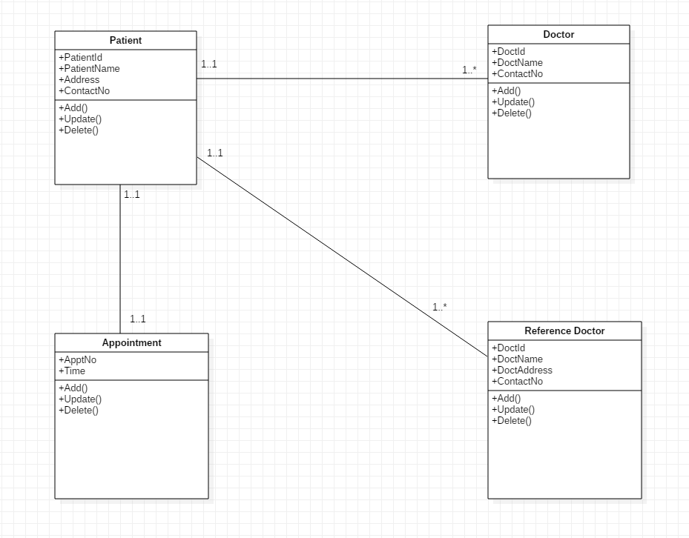
Class Diagram
The class diagram are used to identify and classify the objects with constitute a system. It also includes the important attributes of the objects which must be captured.
Represents main classes: Patient, Doctor, Admin, Appointment.

Slide 11
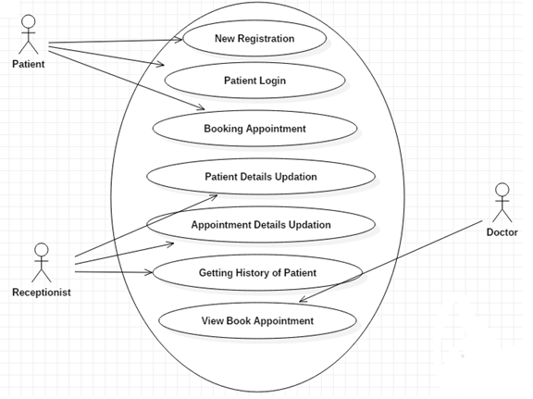
Use Case Diagram
Use Case Diagram is used to identify the “uses” or use cases of the new system-- in other words, to identify how the system will be used .The Use Case Diagram is essentially an extension of the Event Table.
Illustrates interactions between system and users

Slide 12
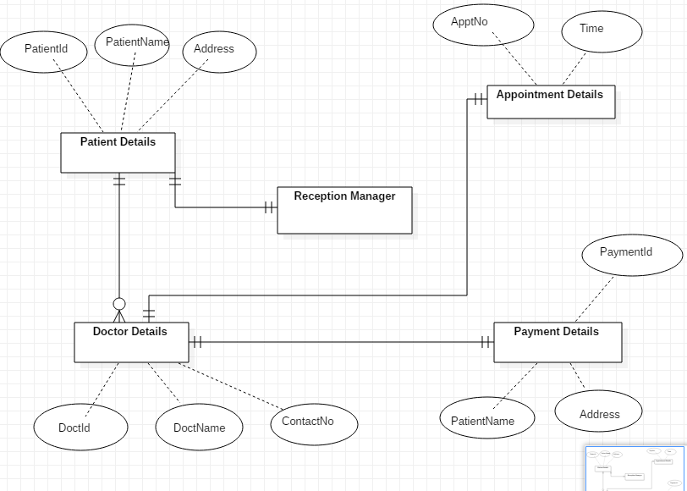
ER Diagram
The entity – relationship (ER) data model allows us to describe the data involved in a real world enterprise in terms of object and their relationships and is widely used to develop an initial database design.
Database structure showing relationships

Slide 13
System Implementation
Modules: Patient, Doctor, Admin
Key Pages: Login, Register, Appointment
Database connectivity and validation

Slide 14
Testing Summary
Unit Testing: individual modules
Integration Testing: module interaction
Real-time user feedback and correction

Slide 15
Conclusion and Future Scope
System simplifies medical appointment booking
Saves time, improves accessibility
Future enhancements: online payments, reviews, mobile app

Slide 16
Thank you

